Slide 1
Econ 7900
Statistics for Data Science
Instructor: CAO Kang Hua 曹康華
Lecture 2
Probabilities

Slide 2
Random Phenomena
Phenomena are any observable occurrences.
With a small number of observations, outcomes of random phenomena may look quite different from what you expect.
With a large number of observations, summary statistics settle down and get increasingly closer to particular numbers.

Slide 3
Random Phenomena
As we make more observations, the proportion of times that a particular outcome occurs gets closer and closer to a certain number we would expect.
This long-run proportion provides the basis for the definition of probability.

Slide 4
Long-Run Behavior of Random Outcomes
With random phenomena, the proportion of times that something happens is highly random and variable in the short run but very predictable in the long run.
For example, as one tosses a die, in the long run the number of times a 6 occurs becomes more predictable and less random. It gets closer and closer to 1/6.
We will interpret the probability of an outcome to represent long-run results.

Slide 5
Probability Quantifies Long-Run Randomness
With any random phenomena, the probability of a particular outcome is the proportion of times that the outcome would occur in a long run of observations.
Since a probability is a proportion, it takes a value between 0 and 1.
Example: a roll of a fair die has outcome 6 with probability 1/6 in a long run of observations.

Slide 6
Independent Trials
Different trials of a random phenomenon are independent if the outcome of any one trial is not affected by the outcome of any other trial.
Example: With independent trials, whether you get a 5 on one roll of a fair die does not affect whether you get a 5 on the following roll.
The law of large numbers, which gamblers invoke as the law of averages, only guarantees long-run performance. In the short run, the variability may well exceed what you expect.

Slide 7
Finding Probabilities
We sometimes can find probabilities by making assumptions about the nature of the random phenomenon. For instance, by symmetry, it may be reasonable to assume that the possible outcomes of that phenomenon are equally likely.
In theory, we could observe several trials of a random phenomenon and use the proportion of times an outcome occurs as its probability. In practice, this is imperfect. The sample proportion merely estimates the actual probability, and only for a very large number of trials is it necessarily close.

Slide 8
Types of Probability: Relative Frequency and Subjective Probability
The relative frequency definition of probability is the long run proportion of times that the outcome occurs in a very large number of trials - not always helpful.
When a long run of trials is not feasible, you must rely on subjective information. In this subjective definition of probability, the probability of an outcome is defined to be a personal probability – your degree of belief that the outcome will occur, based on the available information.
Bayesian statistics is a branch of statistics that uses subjective probability as its foundation.

Slide 9
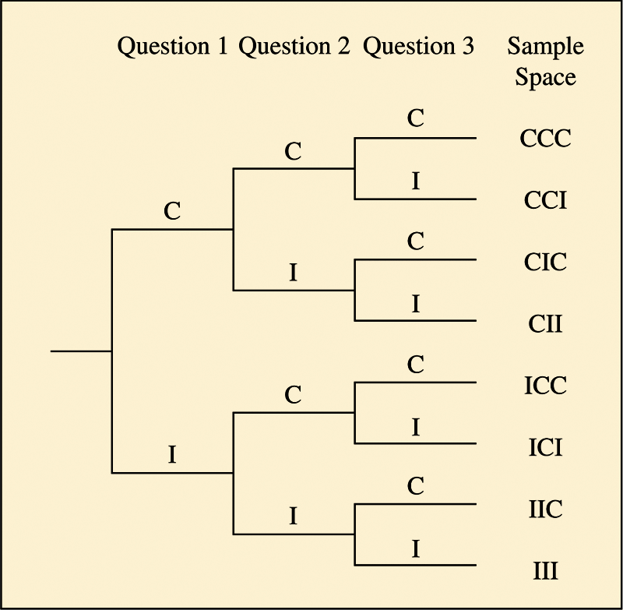
Sample Space
For a random phenomenon, the sample space is the set of all possible outcomes.
Figure 5.3 Tree Diagram for Student Performance on a Three-Question Pop Quiz. Each path from the first set of two branches to the third set of eight branches determines an outcome in the sample space. Question: How many possible outcomes would there be if the quiz had four questions?
From the tree diagram, a student’s performance has eight possible outcomes: {CCC, CCI, CIC, CII, ICC, ICI, IIC, III}.

Slide 10
Events
An event is a subset of the sample space. An event corresponds to a particular outcome or a group of possible outcomes.
Example:
For a student taking the three-question pop quiz, some possible events are:
  Event A = student answers all 3 questions correctly = {CCC}
  Event B = student passes (at least 2 correct) =
  {CCI, CIC, ICC, CCC}.

Slide 11
Finding Probabilities of Events
Each outcome in a sample space has a probability. So does each event. To find such probabilities, we list the sample space and specify plausible assumptions about its outcomes.
  The probability of each individual outcome is between 0 and 1.
  The total of all the individual probabilities equals 1.

Slide 12
SUMMARY: Probability of an Event
The probability of an event A, denoted by P(A), is obtained by adding the probabilities of the individual outcomes in the event.
When all the possible outcomes are equally likely,

Slide 13
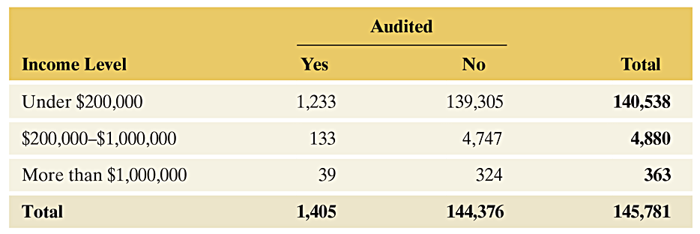
Example: Tax Audit
Table 5.2 Contingency Table Cross-Tabulating Tax Forms by Income Level and Whether Audited. There were 145.8 million returns filed. The frequencies in the table are reported in thousands. For example, 1,233 represents 1,233,000 tax forms that reported income under $200,000 and were audited.

Slide 14
Example: Tax Audit
What is the sample space for selecting a taxpayer?
  {(under $200,000, Yes)
  (under $200,000, No)
  ($200,000 - $1,000,000, Yes)
  .
  .
  .
  6. (More than $1,000,000, No)}

Slide 15
Example: Tax Audit
For a randomly selected taxpayer in 2013:
What is the probability of an audit?
  1405/145,781 = 0.0096, or about 1 in 100 chance.
What is the probability of the return showing an income of more than $1,000,000?
  (39 + 324)/145,781 = 0.0025, or about 1 in 400 chance

Slide 16
Basic Rules for Finding Probabilities About a Pair of Events
Some events are expressed as the outcomes that:
  are not in some other event (complement of the event).
  are in one event and in another event (intersection of two events).
  are in one event or in another event or in both events (union of two events).

Slide 17
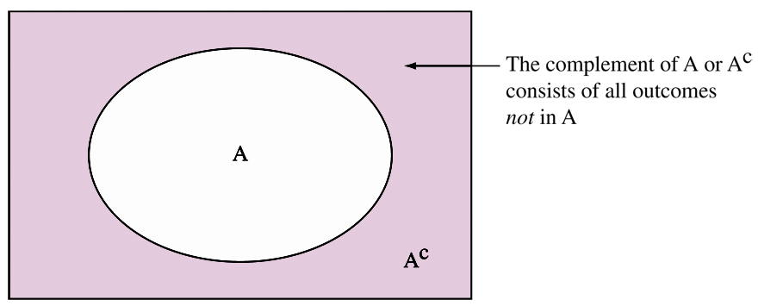
The Complement of an Event
The complement of an event A consists of all outcomes in the sample space that are not in A. It is denoted by A^{c}.
The probabilities of A and of A^{c} add to 1, so P(A^{c}) = 1 – P(A).
Figure 5.4 Venn Diagram Illustrating an Event A and Its Complement A^{c}. Question
Can you sketch a Venn diagram of two events A and B such that they share some common
outcomes, but some outcomes are only in A or only in B?

Slide 18
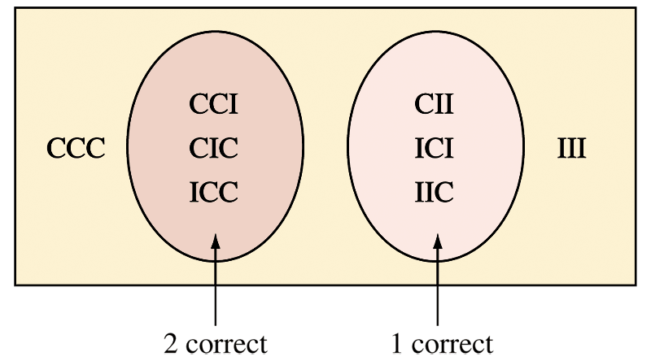
Disjoint Events
Two events, A and B, are disjoint if they do not have any common outcomes.
Figure 5.5 Venn Diagram Illustrating Disjoint Events. The event of a student answering exactly one question correctly is disjoint from the event of answering exactly two questions correctly. Question: Identify on this figure the event that the student answers the first question correctly. Is this event disjoint from either of the two events identified in the Venn diagram?

Slide 19
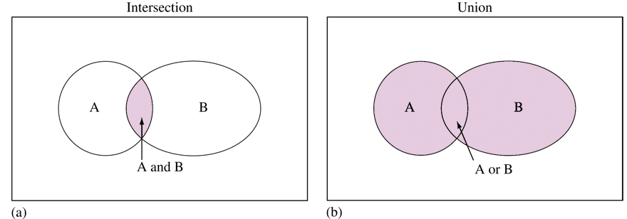
Intersection of Two Events
The intersection of A and B consists of outcomes that are in both A and B.
Figure 5.6 The Intersection and the Union of Two Events. Intersection means A occurs and B occurs, denoted “A and B.” The intersection consists of the shaded “overlap” part in Figure 5.6 (a). Union means A occurs or B occurs or both occur, denoted “A or B.” It consists of all the shaded parts in Figure 5.6 (b). Question: How could you find P(A or B) if you know P(A), P(B), and P(A and B)?

Slide 20
Union of Two Events
The union of A and B consists of outcomes that are in A or in B or both.
Figure 5.6 The Intersection and the Union of Two Events. Intersection means A occurs and B occurs, denoted “A and B.” The intersection consists of the shaded “overlap” part in Figure 5.6 (a). Union means A occurs or B occurs or both occur, denoted “A or B.” It consists of all the shaded parts in Figure 5.6 (b). Question: How could you find P(A or B) if you know P(A), P(B), and P(A and B)?

Slide 21
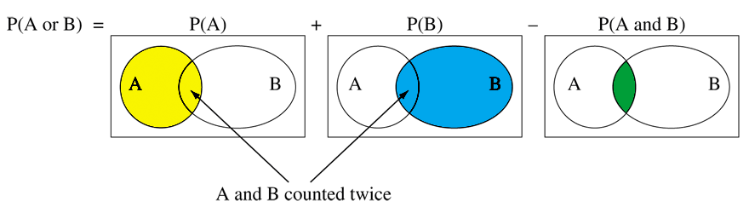
Addition Rule: Finding the Probability That Even A or Event B Occurs
Addition Rule: Probability of the Union of Two Events
  For the union of two events,
  P(A or B) = P(A) + P(B) – P(A and B).
  P(A and B) = P(A) + P(B) – P(A or B)
  If the events are disjoint, then P(A and B) = 0, so
  P(A or B) = P(A) + P(B).
Figure 5.7 The Probability of the Union, Outcomes in A or B or Both. Add P(A) to P(B) and subtract P(A and B) to adjust for outcomes counted twice. Question: When does P(A or B) = P(A) + P(B)?

Slide 22
Example: Probability of the Union of Two Events
Consider a family with two children. The sample space possibilities for the genders of the two children are {FF, FM, MF, MM}. Assume the four outcomes in the sample space are equally likely.
Let A = {first child a girl}.
Let B = {second child a girl}.
P(A) = P({FF, FM}) = 0.50,
P(B) = P({FF, MF}) = 0.50, and P(A and B) = P({FF}) = 0.25
The event A or B is the event that the first child is a girl, or the second child is a girl, or both, that is, at least one child is a girl. Its probability is:
P(A or B) = P(A) + P(B) - P(A and B) = 0.50 + 0.50 - 0.25 = 0.75.

Slide 23
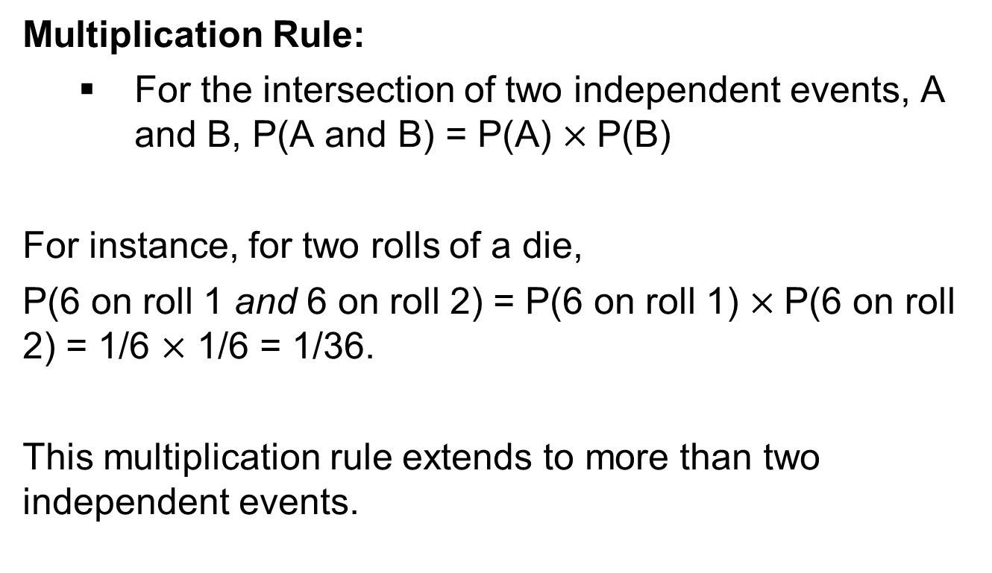
Multiplication Rule: Finding the Probability That Events A and B Both Occur

Slide 24
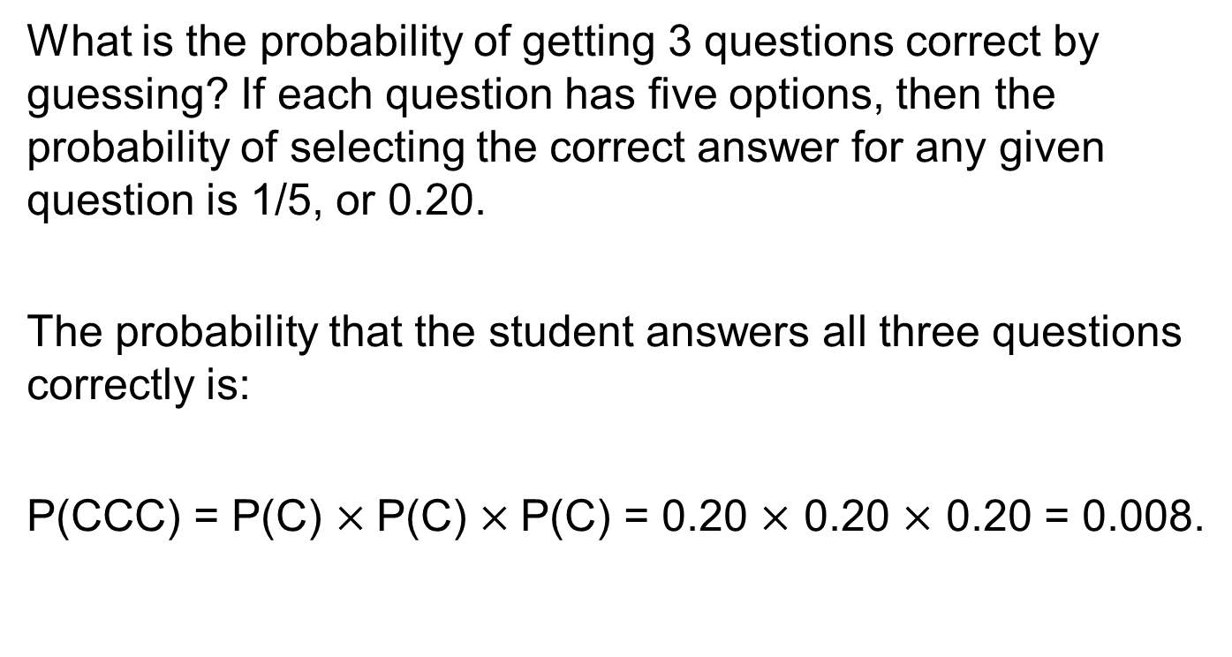
Example: Guessing yet Passing a Pop Quiz

Slide 25
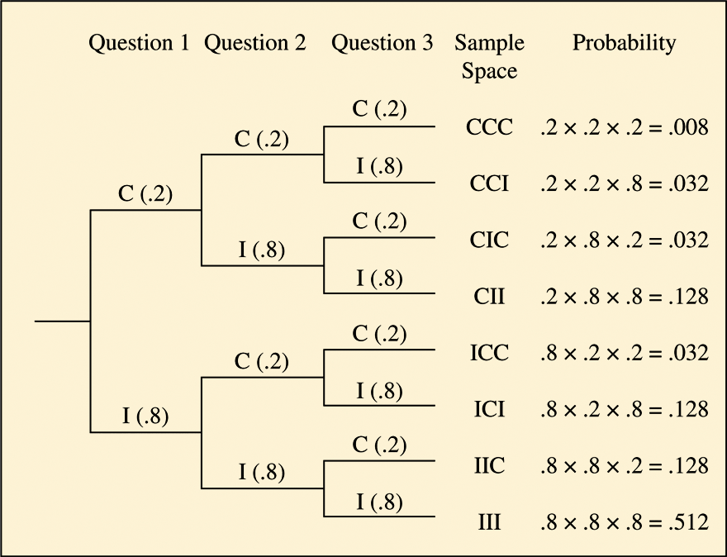
Example: Guessing yet Passing a Pop Quiz
Figure 5.8 is a tree diagram showing how to multiply probabilities to find the probabilities for all eight possible outcomes.
Figure 5.8 Tree Diagram for Guessing on a Three-Question Pop Quiz. Each path from the first set of branches to the third set determines one sample space outcome. Multiplication of the probabilities along that path gives its probability, when trials are independent.

Slide 26
Example: Guessing yet Passing a Pop Quiz
What is the probability that a student answers at least 2 questions correctly?
  P(CCC) + P(CCI) + P(CIC) + P(ICC) = 0.008 + 3(0.032) = 0.104.
  In summary, there is only about a 10% chance of passing
  when a student randomly guesses the answers.

Slide 27
Events Often Are Not Independent
In practice, events need not be independent.
Don’t assume that events are independent unless you have given this assumption careful thought and it seems plausible.

Slide 28
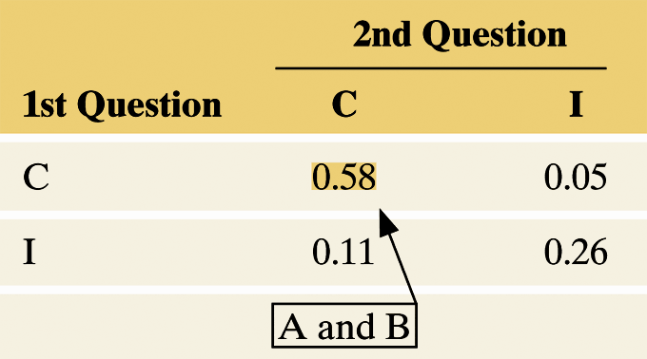
Example: Events Often Are Not Independent
A Quiz With Only 2 Multiple Choice Questions
  Data giving the proportions for the actual responses of students in a class
  (I = incorrect, C = correct) :
  Outcome: II IC CI CC
  Probability: 0.26 0.11 0.05 0.58
Notes:
28

Slide 29
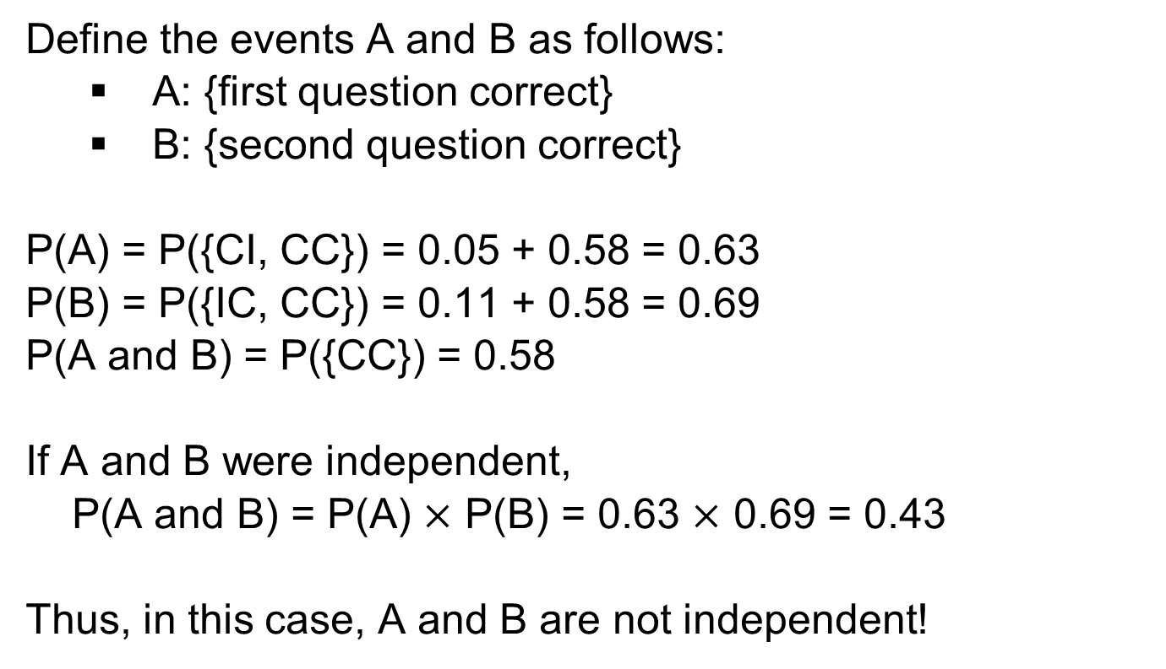
Example: Events Often Are Not Independent
Notes:
29

Slide 30
Finding the Conditional Probability of an Event
For events A and B, the conditional probability of event A, given that event B has occurred, is:
P(A|B) is read as “the probability of event A, given event B.” The vertical slash represents the word “given”. Of the times that B occurs, P(A|B) is the proportion of times that A also occurs.

Slide 31
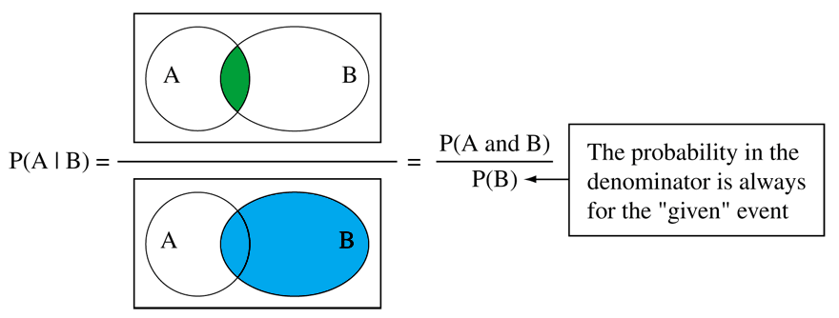
Conditional Probability
Figure 5.9 Venn Diagram of Conditional Probability of Event A Given Event B. Of the cases in which B occurred, P(A|B) is the proportion in which A also occurred. Question: Sketch a representation of P(B|A). Is P(A|B) necessarily equal to P(B|A)?

Slide 32
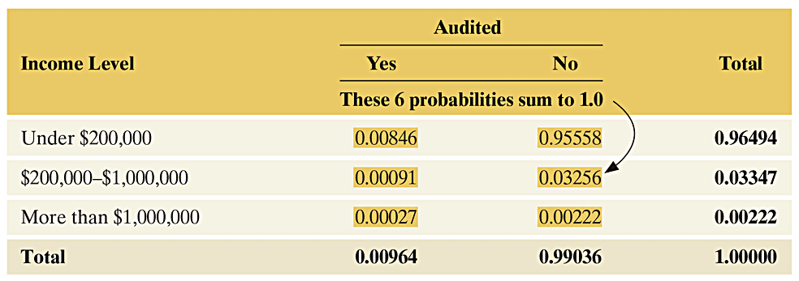
Example: Conditional Probabilities on Audited Given the Income Level
Table 5.3 Probabilities of Taxpayers at the Six Possible Combinations of Income Level and Audited Each frequency in Table 5.2 was divided by 145,781 to obtain the cell probabilities shown here, such as 1,233/145,780 = 0.008.

Slide 33
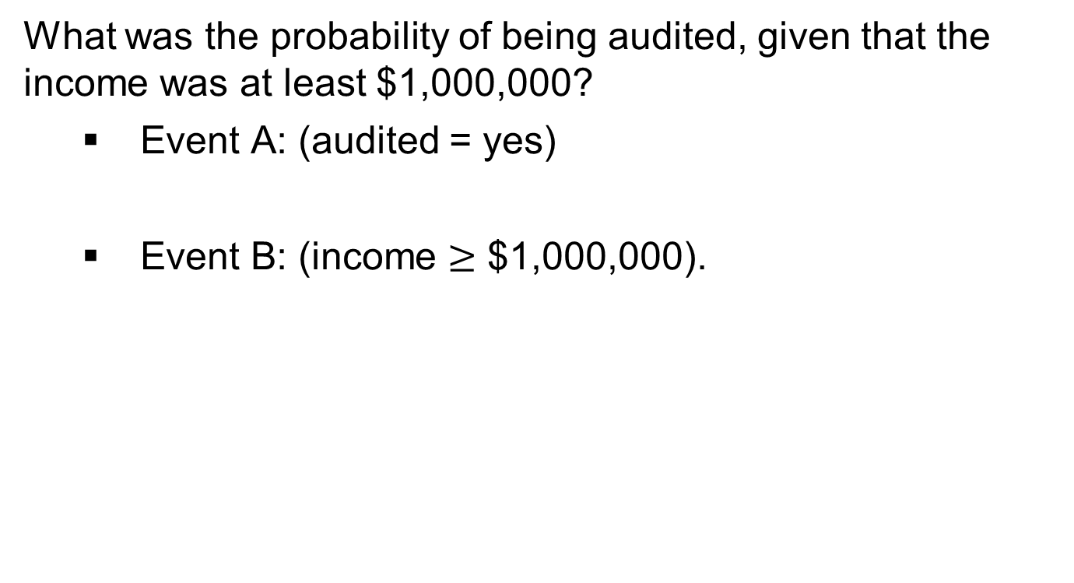
Example: Conditional Probabilities on Audited Given the Income Level

Slide 34
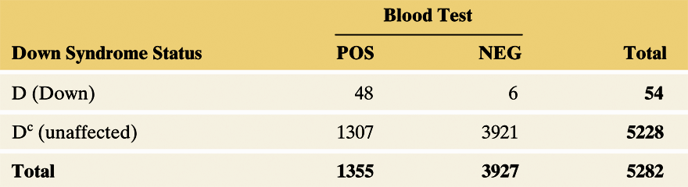
Example: The Triple Blood Test for Down Syndrome
A study of 5282 women aged 35 or over analyzed the Triple Blood Test to test its accuracy.
Notes:
34

Slide 35
Example: The Triple Blood Test for Down Syndrome
A positive test result states that the condition is present.
A negative test result states that the condition is not present.
False Positive: Test states the condition is present, but it is actually absent.
False Negative: Test states the condition is absent, but it is actually present.
Notes:
35

Slide 36
Example: The Triple Blood Test for Down Syndrome
Assuming the sample is representative of the population, estimate the probability of a positive test for a randomly chosen pregnant woman 35 years or older.
P(POS) = 1355/5282 = 0.257
Notes:
36

Slide 37
Example: The Triple Blood Test for Down Syndrome
Given that the diagnostic test result is positive, estimate the probability that Down syndrome truly is present.
Summary: Of the women who tested positive, fewer than 4% actually had fetuses with Down syndrome.
Notes:
37

Slide 38
Multiplication Rule for Finding P(A and B)
For events A and B, the probability that A and B both occur equals:
Applying the conditional probability formula, we also see that
Notes:
38

Slide 39
Example: Double Faults in Tennis
  Assuming these are typical of his serving performance, what is the probability that he makes a double fault when he serves?
Novak Djokavic – 2014 men’s champion in the Wimbledon tennis tournament
  He made 62% of his first serves.
  He faulted on his first serve the other 38% of the time.
  Given that he made a fault with his first serve, he made a fault on his second serve only 4.5% of the time.
Notes:
39

Slide 40
Example: Double Faults in Tennis
Let F1 be the event that Djokovic makes a fault with the first serve, and let F2 be the event that he makes a fault with the second serve.
The event that Djokovic makes a double fault is “F1 and F2.”
Djokovic makes a double fault in 1.7% of all his service points.
Notes:
40

Slide 41
Independent Events Defined Using Conditional Probabilities
Two events A and B are independent if the probability that one occurs is not affected by whether or not the other event occurs.
Events A and B are independent if:
  , or equivalently,
If events A and B are independent,
Notes:
41

Slide 42
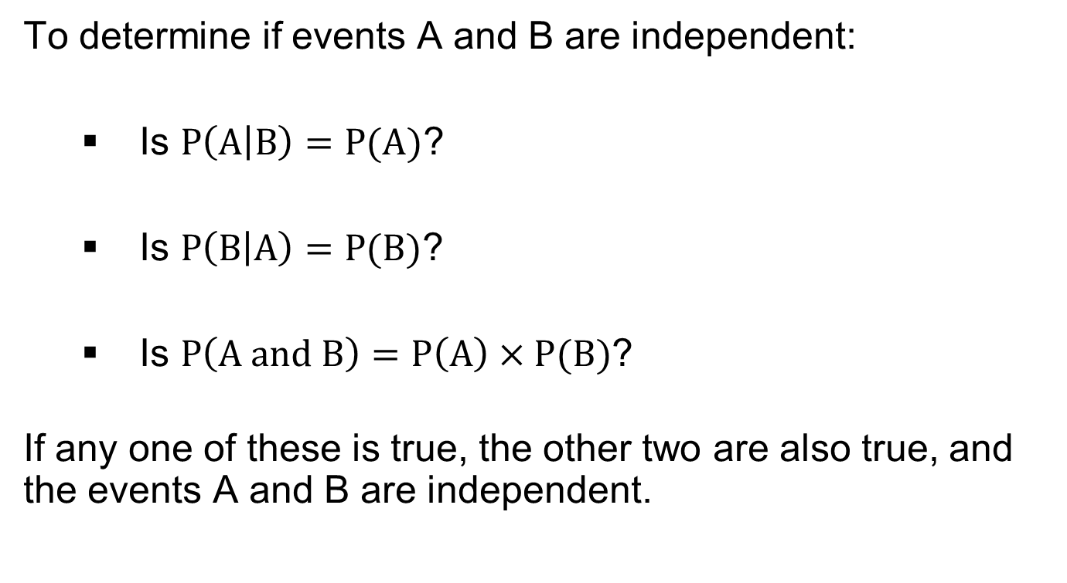
SUMMARY: Checking for Independence
Notes:
42

Slide 43
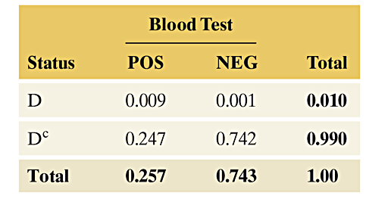
Example: Down Syndrome Again
The diagnostic blood test for Down syndrome:
  POS = positive result NEG = negative result
  D = Down Syndrome D^{C} = Unaffected
Notes:
43

Slide 44
Example: Down Syndrome Again
Are the events POS and D independent or dependent?
Meaning is true?
The events POS and D are dependent.
Notes:
44

Slide 45
Is a Coincidence Truly an Unusual Event?
Out of the large number of things that can happen to us and to others over time, it’s not surprising to occasionally see patterns that seem unusual.
Notes:
45

Slide 46
Example: Matching Birthdays
What is the probability that at least two students in a group of 25 students have the same birthday?
P(at least one match) = 1 – P(no matches)
P(no matches) = P(students 1 and 2 and 3 …and 25 have different birthdays) = (364/365)*(363/365)*…*(341/365) = 0.43
Notes:
46

Slide 47
Example: Matching Birthdays
Using the probability for the complement of an event,
P(at least one match) = 1 – P(no matches) = 1 – 0.43 = 0.57
The probability exceeds 1/2 of at least one birthday match in a class of 25 students.
Not so surprising when you consider that there are 300 pairs of students who can share the same birthday!
Notes:
47

Slide 48
Probability Model
We’ve now found probabilities in many idealized situations.
In practice, it’s often not obvious when different outcomes are equally likely or different events are independent.
When calculating probabilities, it is advisable to specify a probability model that spells out all the assumptions made.

Slide 49
Probability Model
A probability model specifies the possible outcomes for a sample space and provides assumptions on which the probability calculations for events composed of these outcomes are based.
Probability models merely approximate reality.

Slide 50
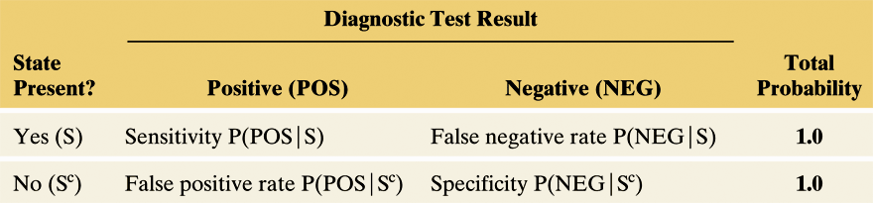
Probabilities and Diagnostic Testing
Table 5.6 Probabilities of Correct and Incorrect Results in Diagnostic Testing
The probabilities in the body of the table refer to the test result, conditional on whether the state (S) is truly present.
The sensitivity and specificity are the probabilities of the two types of correct diagnoses.

Slide 51
Example: Random Drug Testing of Air Traffic Controllers
Based on past drug testing of air traffic controllers, the FAA reports that the probability of drug use at a given time is approximately 0.007 (less than 1%). This is called prevalence of drug use.
Given the probability of drug use, P(S) = 0.007
Sensitivity of test = P(POS|S) = 0.96
Specificity of test = P(NEG|S^{C}) = 0.93

Slide 52
Example: Random Drug Testing of Air Traffic Controllers
What is the probability of a positive test result?
Even though the prevalence is < 1%, there is nearly an 8% chance of the test suggesting that the person used drugs.

Slide 53
Bayes' rule
Suppose the probability of A occurring depends upon whether B occurred, and vice versa.
In the former case, we write p(A|B). In the latter case, we write p(B|A).
Then, the probability that we’ll get A and B is given by
p(A and B) = p(A)*p(B|A) = p(B)*p(A|B).

Slide 54
Bayes' rule
So, p(A)*p(B|A) = p(B)*p(A|B). Assuming that p(A) ≠ 0, we can divide both sides of the latter equation by p(A) and discover Bayes’ Rule:
p(B|A) = p(B)*p(A|B)/p(A)
Note that p(A) = p(A|B)*p(B) + p(A|not B)*p(not B) .

Slide 55
Bayes' rule - Example
Mr. Smith's gardener is not dependable; the probability that he will forget to water the rosebush during Smith's absence is 2/3. The rosebush is in questionable condition anyhow; if watered, the probability of its withering is 1/2, but if it is not watered, the probability of its withering is 3/4. Upon returning, Smith finds that the rosebush has withered. What is the probability that the gardener did not water the rosebush?

Slide 56
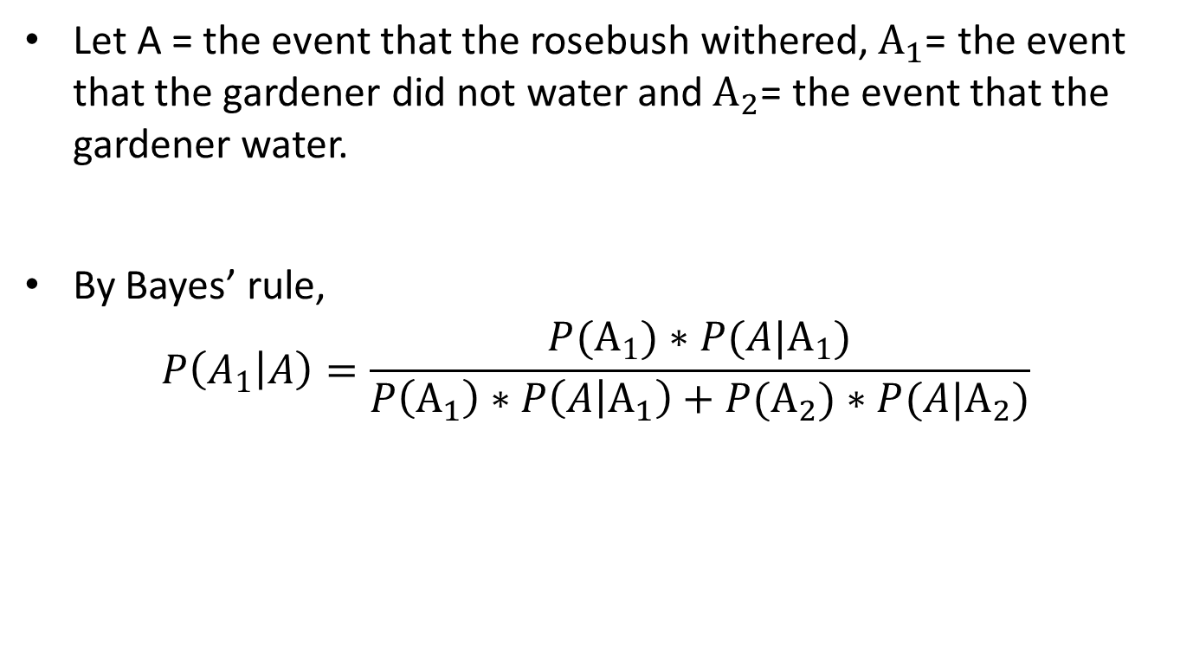
Bayes' rule - Example
Let A = the event that the rosebush withered,${ A}_{1}$= the event that the gardener did not water and${ A}_{2}$= the event that the gardener water.
By Bayes’ rule,
$$P\left(A_{1} | A\right)=\frac{P(A_{1})∗P(A|A_{1})}{P\left(A_{1}\right)∗P\left(A | A_{1}\right)+P(A_{2})∗P(A|A_{2})}$$

Slide 57
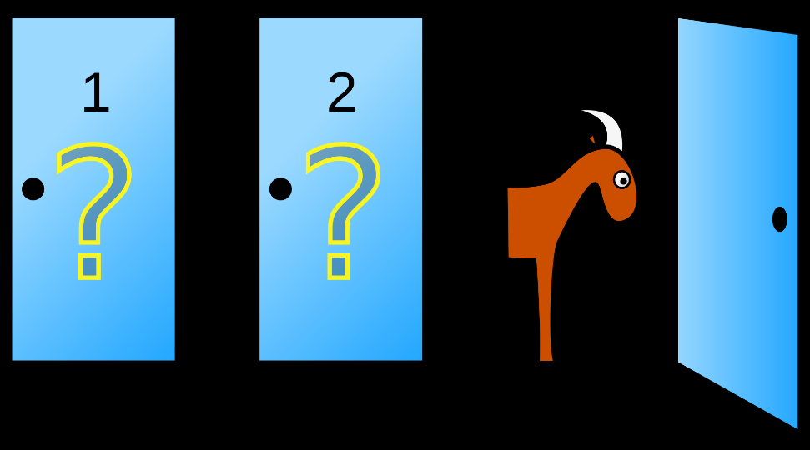
Monty Hall problem
Suppose you're on a game show, and you're given the choice of three doors: Behind one door is a car; behind the others, goats.
You pick a door, say No. 1, and the host, who knows what's behind the doors, opens another door, say No. 3, which has a goat. He then says to you, "Do you want to pick door No. 2?"
Is it to your advantage to switch your choice?

